Slide 1



Capstone Project: Summary Report
This presentation summarizes the findings of the capstone project by exploring a healthcare dataset. We'll delve into key insights and trends, revealing potential areas for improvement.

Slide 2
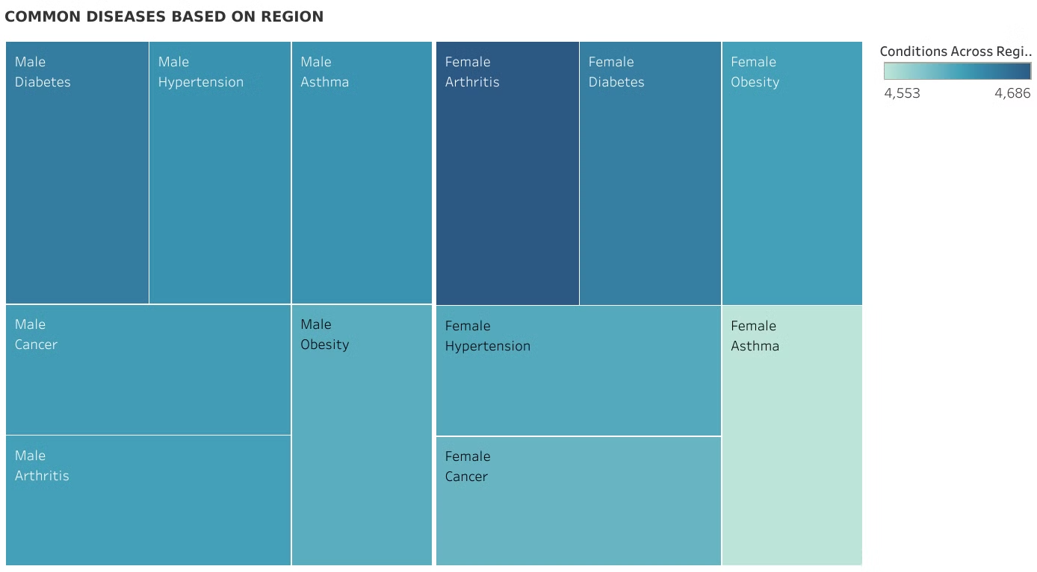
Explore the Data

Slide 3
Explore the Data
Common Diagnoses
Diabetes is the most common diagnosis for males, while Arthritis is more frequent for females.
Success Rates
There is a generally high success rate in diagnosing illnesses. However, a significant 33% of diagnoses are inconclusive, suggesting the need for further testing.

Slide 4
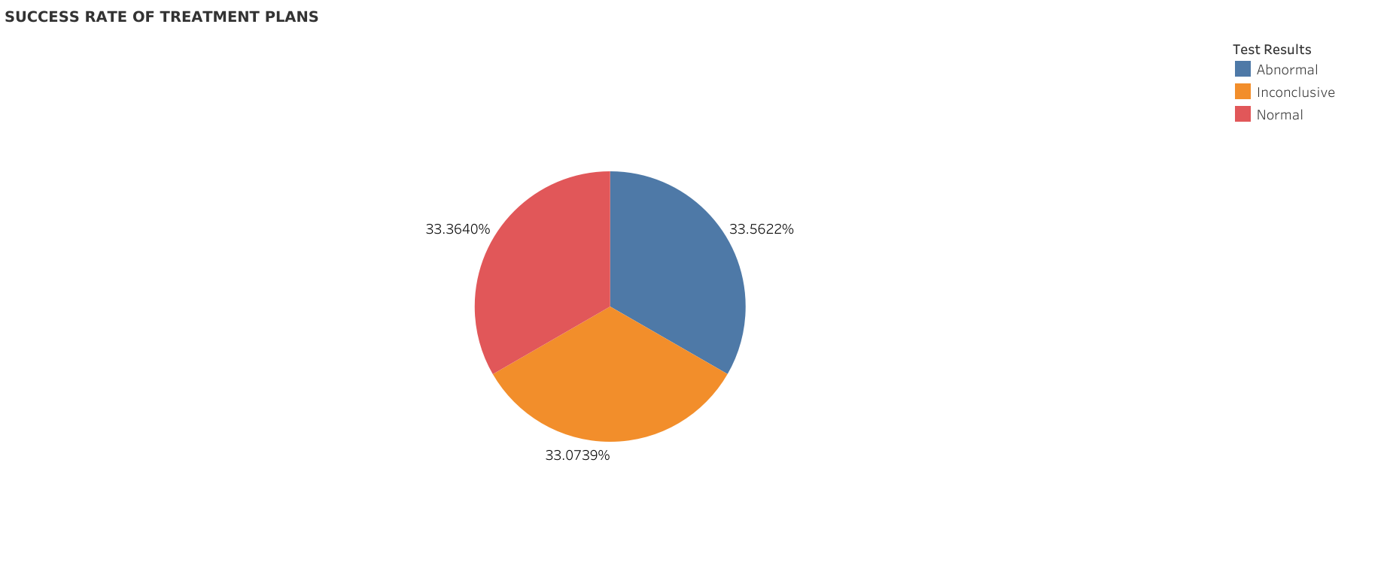

Slide 5
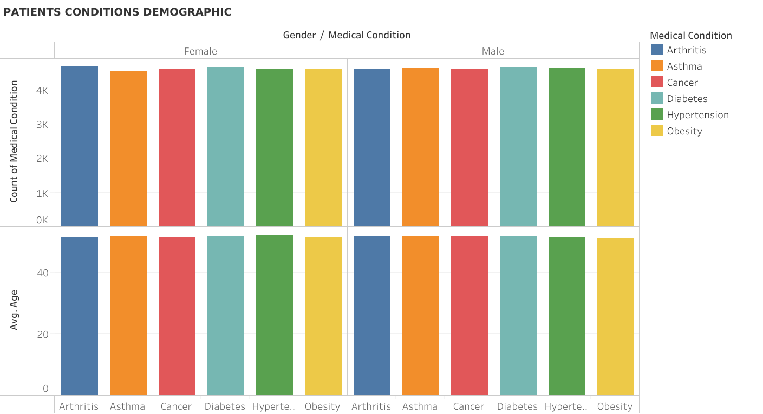
1

Slide 6
Demographics of Patients
1
Age and Risk
2
Potential Factors
This trend suggests potential influences of inheritance or lifestyle choices on disease development.
Both genders demonstrate a rising risk of life-threatening diseases from their early 20s to old age.

Slide 7
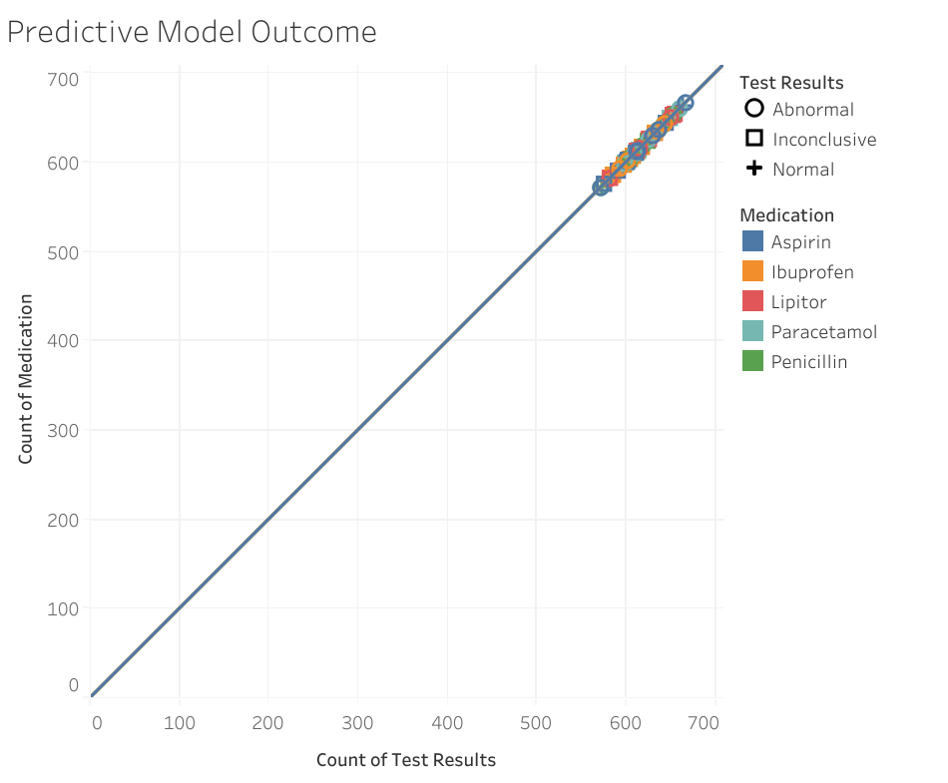
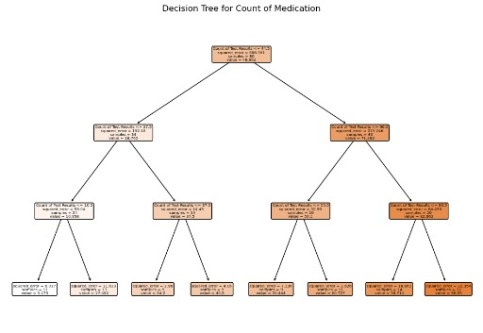
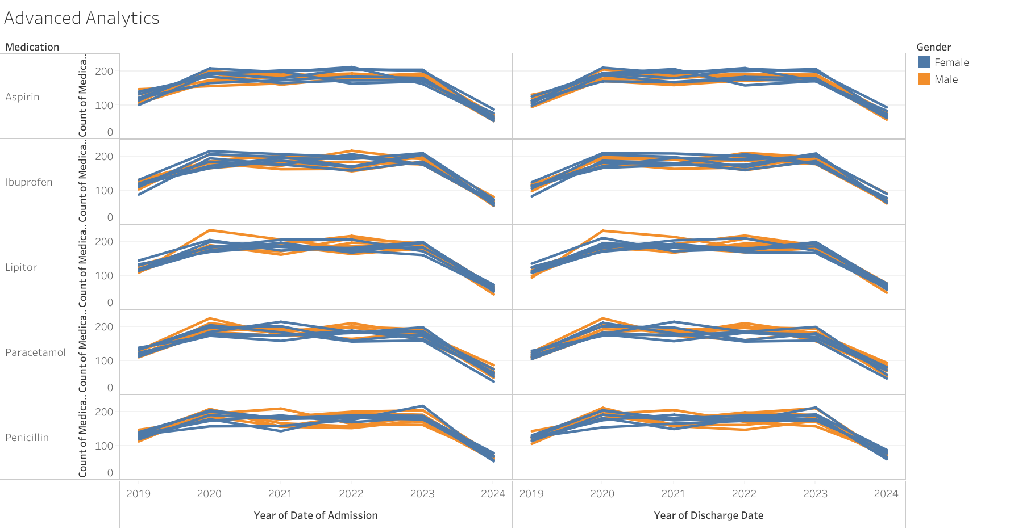
Generate Data
Randomly Generate Text Result
Calculate Medication Count
Prepare Data For Model
Train Decision Tree Model
Visualize Decision Tree
End Decision Tree Ready for Prediction

Slide 8
Predictive Analytics
Predictive Model
Key Findings
Regression analysis was employed to predict patient outcomes based on factors such as age, treatment type, and diagnosis.
The model suggests a significant relationship between the number of test results and the number of medications prescribed, indicating that additional tests likely lead to additional medication.

Slide 9


Predictive Model Details
Equation
Coefficients
The model shows a direct and significant relationship between the count of test results and the count of medication, with every additional test result leading to one more medication prescribed.
Count of Medication = 1\*Count of Test Results + 0

Slide 10
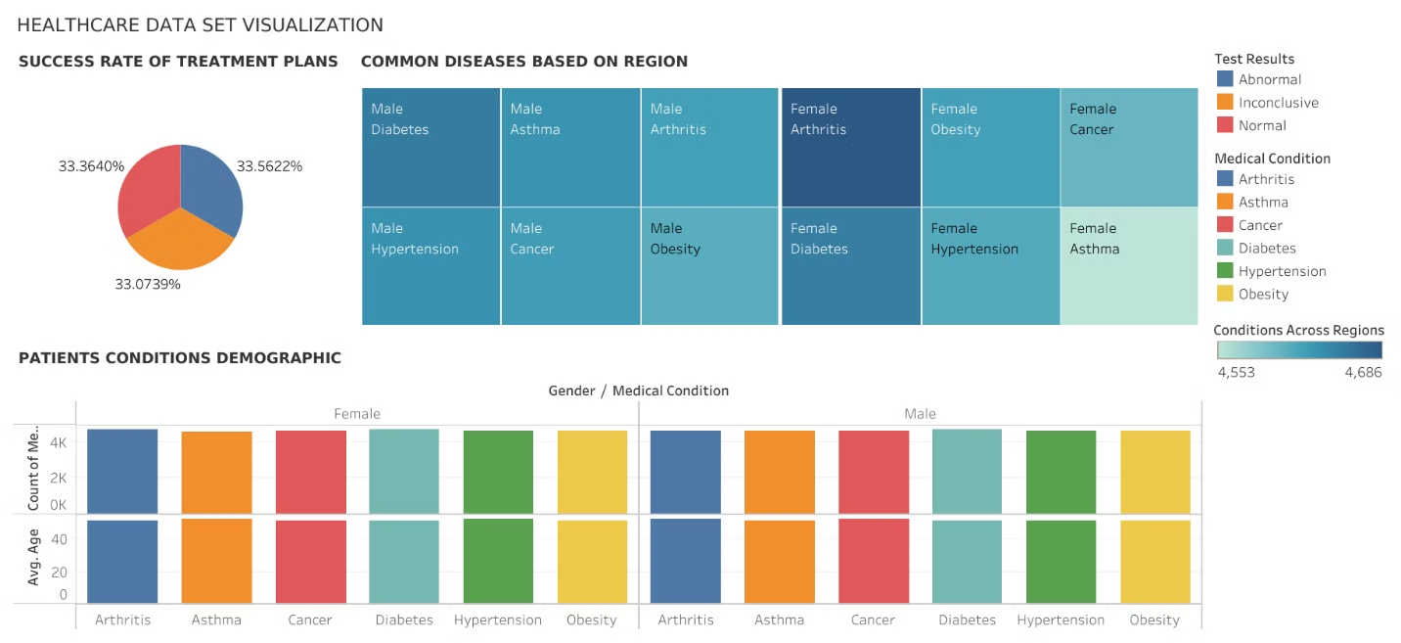
Conclusion

Slide 11
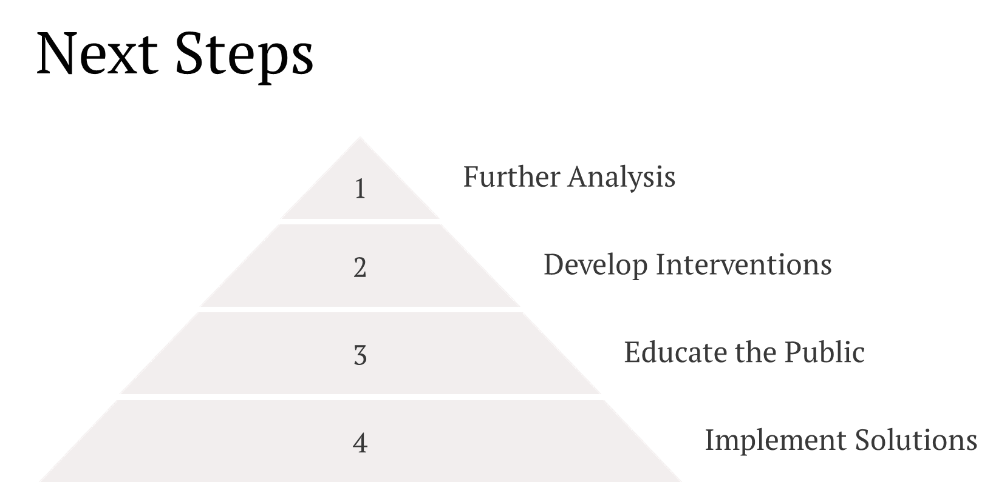

Slide 12
Recommendations
Public Awareness
Healthcare Access
Increase public awareness about the importance of early detection and preventive measures.
Improve accessibility to affordable healthcare services for all populations.
Data-Driven Solutions
Continue utilizing predictive analytics to identify and address potential health risks.

